Slide 1
Cloud Security and Privacy

Slide 2
Infrastructure Security
Network Level
Host Level
Application Level

Slide 3
The Network Level
Ensuring confidentiality and integrity of your organization’s data-in-transit to and from your public cloud provider
Ensuring proper access control (authentication, authorization, and auditing) to whatever resources you are using at your public cloud provider
Ensuring availability of the Internet-facing resources in a public cloud that are being used by your organization, or have been assigned to your organization by your public cloud providers
Replacing the established model of network zones and tiers with domains

Slide 4
The Network Level - Mitigation
Note that network-level risks exist regardless of what aspects of “cloud computing” services are being used
The primary determination of risk level is therefore not which IaaS/PaaS/SaaS is being used
But rather whether your organization intends to use or is using a public, private, or hybrid cloud.

Slide 5
The Host Level
SaaS/PaaS
Both the PaaS and SaaS platforms abstract and hide the host OS from end users
Host security responsibilities are transferred to the CSP (Cloud Service Provider)
You do not have to worry about protecting hosts
However, as a customer, you still own the risk of managing information hosted in the cloud services.

Slide 6
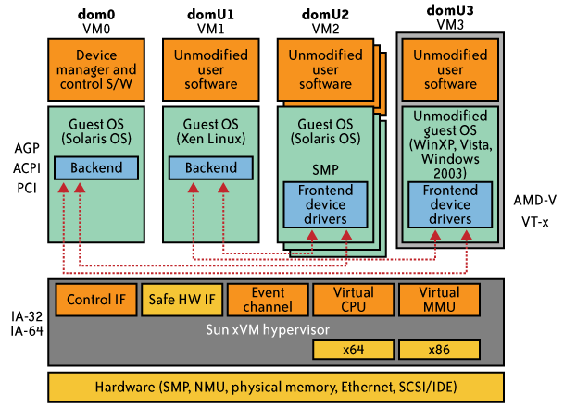
The Host Level (cont.)
IaaS Host Security
Virtualization Software Security
Hypervisor (also called Virtual Machine Manager (VMM)) security is a key
a small application that runs on top of the physical machine H/W layer
implements and manages the virtual CPU, virtual memory, event channels, and memory shared by the resident VMs
Also controls I/O and memory access to devices.
Bigger problem in multitenant architectures
Customer guest OS or Virtual Server Security
The virtual instance of an OS
Vulnerabilities have appeared in virtual instance of an OS
e.g., VMWare, Xen, and Microsoft’s Virtual PC and Virtual Server
Customers have full access to virtual servers.

Slide 7
Case study: Amazon's EC2 infrastructure
“Hey, You, Get Off of My Cloud: Exploring Information Leakage in Third-Party Compute Clouds”
Multiple VMs of different organizations with virtual boundaries separating each VM can run within one physical server
"virtual machines" still have internet protocol, or IP, addresses, visible to anyone within the cloud.
VMs located on the same physical server tend to have IP addresses that are close to each other and are assigned at the same time
An attacker can set up lots of his own virtual machines, look at their IP addresses, and figure out which one shares the same physical resources as an intended target
Once the malicious virtual machine is placed on the same server as its target, it is possible to carefully monitor how access to resources fluctuates and thereby potentially glean sensitive information about the victim

Slide 8
Local Host Security
Are local host machines part of the cloud infrastructure?
Outside the security perimeter
While cloud consumers worry about the security on the cloud provider’s site, they may easily forget to harden their own machines
The lack of security of local devices can
Provide a way for malicious services on the cloud to attack local networks through these terminal devices
Compromise the cloud and its resources for other users
Notes:
The lack of security of local devices can disrupt the consumer and also provide a way for malicious services on the cloud to attack local networks through these terminal devices. In today’s ubiquitous computing environment, the local host machine may well be a desktop computer, a portable laptop or mobile device. While cloud consumers worry about the security on the cloud provider’s site, they may easily forget to harden their own machines. The lack of security of a local host can compromise the cloud and its resources for other users. With mobile devices, the threat may be even stronger, as users misplace or have the device stolen from them. The security mechanisms on handheld gadgets are often times insufficient compared to say, a desktop computer, providing a potential attacker an easy avenue into a cloud system. If a user relies mainly on a mobile device to access cloud data, the threat to availability is also increased as mobile devices malfunction or are lost.
Devices that access the cloud should have strong authentication mechanisms, should be tamper-resistant, and have cryptographic functionality when traffic confidentiality is required. Since this places a part of the security burden onto the consumer, the provider may need to stipulate in its policy or SLA. New approaches to mobile cloud computing in which applications lie in the cloud as opposed to on a smart phone, enable more sophisticated security mechanisms.
Users connect to the cloud from their local host machines.
In particular, many secure cloud data storing technologies require users to generate master keys (used to encrypt data or session keys) and store them on the local machine. If a malicious service in the cloud can tamper with the local machine and access these keys, confidentiality of data stored in the cloud is at risk.
For example, a user’s computer can be a zombie that can be used to attack the cloud. Or it can contain malicious code that damages provider-side resources, affecting not only the provider, but all its other consumers as well.
In today’s battle space, new technologies enable war fighters to use handheld devices to gather data for analysis at command centers. Therefore, the durability and robustness of these devices is a major concern not only for cloud computing but for general-purpose military use as well.
Memory curtaining techniques for sensitive areas of memories such as those places where keys are stored (i.e. provides isolation of sensitive memory areas). Remote attestation or TPM type requirements.

Slide 9
Local Host Security (Cont.)
With mobile devices, the threat may be even stronger
Users misplace or have the device stolen from them
Security mechanisms on handheld gadgets are often times insufficient compared to say, a desktop computer
Provides a potential attacker an easy avenue into a cloud system.
If a user relies mainly on a mobile device to access cloud data, the threat to availability is also increased as mobile devices malfunction or are lost
Devices that access the cloud should have
Strong authentication mechanisms
Tamper-resistant mechanisms
Strong isolation between applications
Methods to trust the OS
Cryptographic functionality when traffic confidentiality is required

Slide 10
The Application Level
DoS
EDoS(Economic Denial of Service)
An attack against the billing model that underlies the cost of providing a service with the goal of bankrupting the service itself.
End user security
Who is responsible for Web application security in the cloud?
SaaS/PaaS/IaaS application security
Customer-deployed application security

Slide 11
Data Security and Storage
Several aspects of data security, including:
Data-in-transit
Confidentiality + integrity using secured protocol
Confidentiality with non-secured protocol and encryption
Data-at-rest
Generally, not encrypted , since data is commingled with other users’ data
Encryption if it is not associated with applications?
But how about indexing and searching?
Then homomorphic encryption vs. predicate encryption?
Processing of data, including multitenancy
For any application to process data, not encrypted

Slide 12
Data Security and Storage (cont.)
Where is (or was) that system located?
What was the state of that physical system?
How would a customer or auditor verify that info?
Data lineage
Knowing when and where the data was located w/i cloud is important for audit/compliance purposes
e.g., Amazon Web Service (AWS)
Store <d1, t1, ex1.s3.amazonaws.com>
Process <d2, t2, ec2.compute2.amazonaws.com>
Restore <d3, t3, ex2.s3.amazonaws.com>
Data provenance
Computational accuracy (as well as data integrity)
E.g., financial calculation: sum ((((2*3)*4)/6) -2) = $2.00 ?
Correct : assuming US dollar
How about dollars of different countries?
Correct exchange rate?

Slide 13
Data Security and Storage
Data remanence
Inadvertent disclosure of sensitive information is possible
Data security mitigation?
Do not place any sensitive data in a public cloud
Encrypted data is placed into the cloud?
Provider data and its security: storage
To the extent that quantities of data from many companies are centralized, this collection can become an attractive target for criminals
Moreover, the physical security of the data centre and the trustworthiness of system administrators take on new importance.
From [6] Cloud Security and Privacy by Mather and Kumaraswamy

Slide 14
Why is Identity and Access Management (IAM)?
Organization’s trust boundary will become dynamic and will move beyond the control and will extend into the service provider domain.
Managing access for diverse user populations (employees, contractors, partners, etc.)
Increased demand for authentication
personal, financial, medical data will now be hosted in the cloud
S/W applications hosted in the cloud requires access control
Need for higher-assurance authentication
authentication in the cloud may mean authentication outside firmware
Limits of password authentication
Need for authentication from mobile devices
From [6] Cloud Security and Privacy by Mather and Kumaraswamy

Slide 15
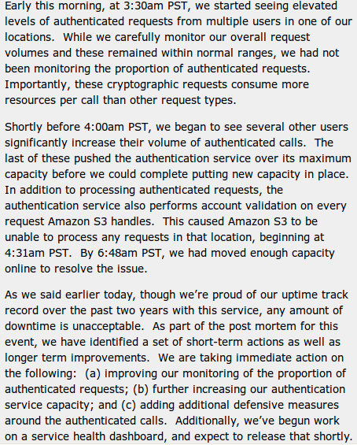
IAM considerations
The strength of authentication system should be reasonably balanced with the need to protect the privacy of the users of the system
The system should allow strong claims to be transmitted and verified w/o revealing more information than is necessary for any given transaction or connection within the service
Case Study: S3 outage
authentication service overload leading to unavailability
2 hours 2/15/08
http://www.centernetworks.com/amazon-s3-downtime-update

Slide 16
What is Privacy?
The concept of privacy varies widely among (and sometimes within) countries, cultures, and jurisdictions.
It is shaped by public expectations and legal interpretations; as such, a concise definition is elusive if not impossible.
Privacy rights or obligations are related to the collection, use, disclosure, storage, and destruction of personal data (or Personally Identifiable Information—PII).
At the end of the day, privacy is about the accountability of organizations to data subjects, as well as the transparency to an organization’s practice around personal information.
From [6] Cloud Security and Privacy by Mather and Kumaraswamy

Slide 17
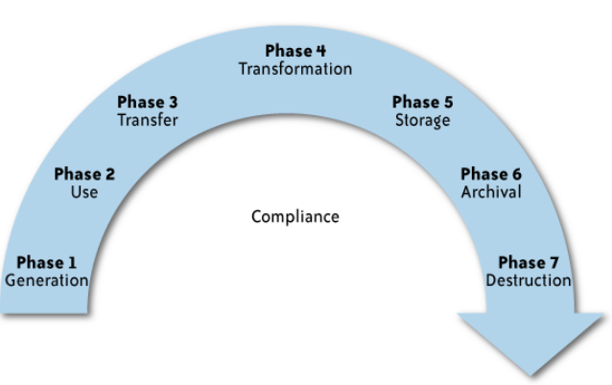
What is the data life cycle?
Personal information should be managed as part of the data used by the organization
Protection of personal information should consider the impact of the cloud on each phase

Slide 18
What Are the Key Privacy Concerns?
Typically mix security and privacy
Some considerations to be aware of:
Storage
Retention
Destruction
Auditing, monitoring and risk management
Privacy breaches
Who is responsible for protecting privacy?

Slide 19
Storage
Is it blended with information from other organizations that use the same Content Security Policy (CSP)?
The aggregation of data raises new privacy issues
Some governments may decide to search through data without necessarily notifying the data owner, depending on where the data resides
Whether the cloud provider itself has any right to see and access customer data?
Some services today track user behaviour for a range of purposes, from sending targeted advertising to improving services

Slide 20
Retention
How long is personal information (that is transferred to the cloud) retained?
Which retention policy governs the data?
Does the organization own the data, or the CSP?
Who enforces the retention policy in the cloud, and how are exceptions to this policy (such as litigation holds) managed?

Slide 21
Destruction
How does the cloud provider destroy PII at the end of the retention period?
How do organizations ensure that their PII is destroyed by the CSP at the right point and is not available to other cloud users?
Cloud storage providers usually replicate the data across multiple systems and sites—increased availability is one of the benefits they provide.
How do you know that the CSP didn’t retain additional copies?
Did the CSP really destroy the data, or just make it inaccessible to the organization?
Is the CSP keeping the information longer than necessary so that it can mine the data for its own use?

Slide 22
Auditing, monitoring and risk management
How can organizations monitor their CSP and provide assurance to relevant stakeholders that privacy requirements are met when their PII is in the cloud?
Are they regularly audited?
What happens in the event of an incident?
If business-critical processes are migrated to a cloud computing model, internal security processes need to evolve to allow multiple cloud providers to participate in those processes, as needed.
These include processes such as security monitoring, auditing, forensics, incident response, and business continuity

Slide 23
Privacy breaches
How do you know that a breach has occurred?
How do you ensure that the CSP notifies you when a breach occurs?
Who is responsible for managing the breach notification process (and costs associated with the process)?
If contracts include liability for breaches resulting from negligence of the CSP?
How is the contract enforced?
How is it determined who is at fault?
From [6] Cloud Security and Privacy by Mather and Kumaraswamy

Slide 24
Who is responsible for protecting privacy?
e.g., Suppose a hacker breaks into Cloud Provider A and steals data from Company X.
Assume that the compromised server also contained data from Companies Y and Z.
Who investigates this crime?
Is it the Cloud Provider, even though Company X may fear that
the provider will try to absolve itself from responsibility?
Is it Company X and, if so, does it have the right to see other data on that server,
including logs that may show access to the data of Companies Y and Z?
Data breaches have a cascading effect
Full reliance on a third party to protect personal data?
In-depth understanding of responsible data stewardship
Organizations can transfer liability, but not accountability
Risk assessment and mitigation throughout the data life cycle is critical.
Many new risks and unknowns
The overall complexity of privacy protection in the cloud represents a bigger challenge.

Slide 25
Part III. Possible Solutions
Minimize Lack of Trust
Policy Language
Certification
Minimize Loss of Control
Monitoring
Utilizing different clouds
Access control management
Identity Management (IDM)
Minimize Multi-tenancy

Slide 26
Security Issues in the Cloud
In theory, minimizing any of the issues would help:
Third Party Cloud Computing
Loss of Control
Take back control
Data and apps may still need to be on the cloud
But can they be managed in some way by the consumer?
Lack of trust
Increase trust (mechanisms)
Technology
Policy, regulation
Contracts (incentives): topic of a future talk
Multi-tenancy
Private cloud
Takes away the reasons to use a cloud in the first place
VPC: its still not a separate system
Strong separation
Notes:
While VPC providers argue that they provide superior isolation, the fact of the matter is that your data is not a separate physical system: your data is still stored on actual servers along with other consumers’ data, but logically separated. If the actual server fails, your data and applications stored on it are lost. Also, there needs to be a high level of trust as to the degree of isolation provided.

Slide 27
Third Party Cloud Computing
Like Amazon’s EC2, Microsoft’s Azure
Allow users to instantiate Virtual Machines
Allow users to purchase required quantity when required
Allow service providers to maximize the utilization of sunk capital costs
Confidentiality is very important

Slide 28
Known issues: Already exist
Confidentiality issues
Malicious behavior by cloud provider
Known risks exist in any industry practicing outsourcing
Provider and its infrastructure needs to be trusted

Slide 29
New Vulnerabilities & Attacks
Threats arise from other consumers
Due to the subtleties of how physical resources can be transparently shared between VMs
Such attacks are based on placement and extraction
A customer VM and its adversary can be assigned to the same physical server
Adversary can penetrate the VM and violate customer confidentiality

Slide 30
More on attacks…
Collaborative attacks
Mapping of internal cloud infrastructure
Identifying likely residence of a target VM
Instantiating new VMs until one gets co-resident with the target
Cross-VM side-channel attacks
Extract information from target VM on the same machine

Slide 31
More on attacks…
Can one determine where in the cloud infrastructure an instance is located?
Can one easily determine if two instances are co-resident on the same physical machine?
Can an adversary launch instances that will be co-resident with other user instances?
Can an adversary exploit cross-VM information leakage once co-resident?
Answer: Yes to all

